Slide 1
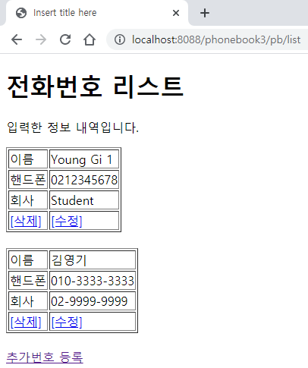
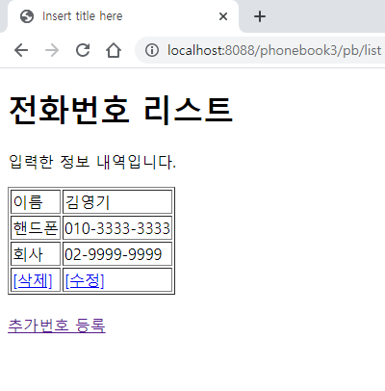
Phonebook3 Spring
01
Delete
web.xml
spring-servlet.xml
controller 패지키위치
Handler Mapping
”/phone/delete” get post → PhoneController delete()
“/phone/list” get post → PhoneController list()
request
파라미터
No=“?”
어트리뷰트
2
PhoneDao 객체
personDelete(no)
사
용
자
1
Front Controller
DispatcherServlet
3
/UpdateForm
PhoneController
Controller
4
ModelAndView
6
5
View
list.jsp
View Resolver
Response
Return ./updateForm
7
DB

Slide 2
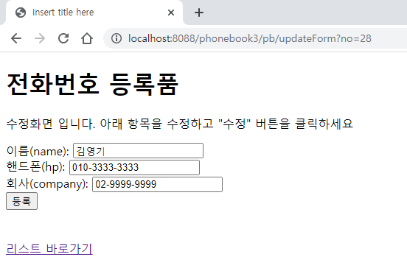
Phonebook3 Spring
01
UpdateForm
web.xml
spring-servlet.xml
controller 패지키위치
Handler Mapping
”/phone/updateForm” get post → PhoneController updateForm()
request
파라미터
No=“?”
어트리뷰트
2
PhoneDao 객체
getPerson(no)
사
용
자
1
Front Controller
DispatcherServlet
3
/Delete
PhoneController
Controller
4
ModelAndView
6
5
View
UpdateForm.jsp
View Resolver
Response
Return ./updateForm
personVo
7
DB

Slide 3
Phonebook3 Spring
01
Update
web.xml
spring-servlet.xml
controller 패지키위치
Handler Mapping
”/phone/update” get post → PhoneController updatge()
“/phone/list” get post → PhoneController list()
request
파라미터
Name = “?”
Hp = “?”
Company =“?”
어트리뷰트
2
PhoneDao 객체
personUpdate(no)
사
용
자
1
Front Controller
DispatcherServlet
3
/Update
PhoneController
Controller
4
ModelAndView
6
5
View
list.jsp
View Resolver
Response
Redirect:./list
7
DB

